Slide 1
iPhone Debug from Mac
Android Debug from Windows
05 August 2024

Slide 2
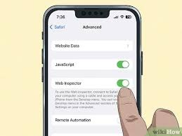
iPhone Debug from Mac
iPhone Setting
Setting > Safari > Advanced > Web Inspector
*** iPhone and Macbook Same Wifi
From iPhone : Trust this computer.

Slide 3
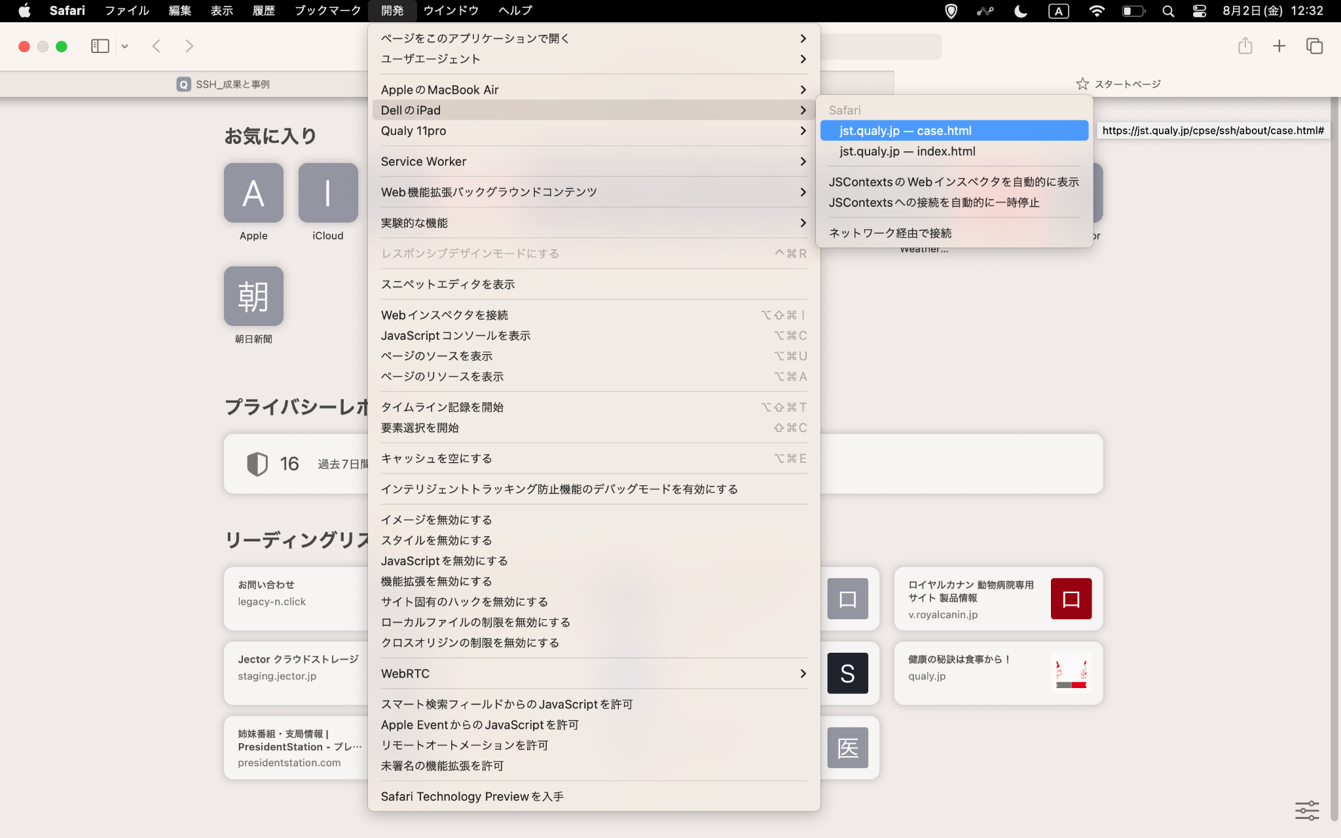
If your phone model name is here, connection is completed.

Slide 4
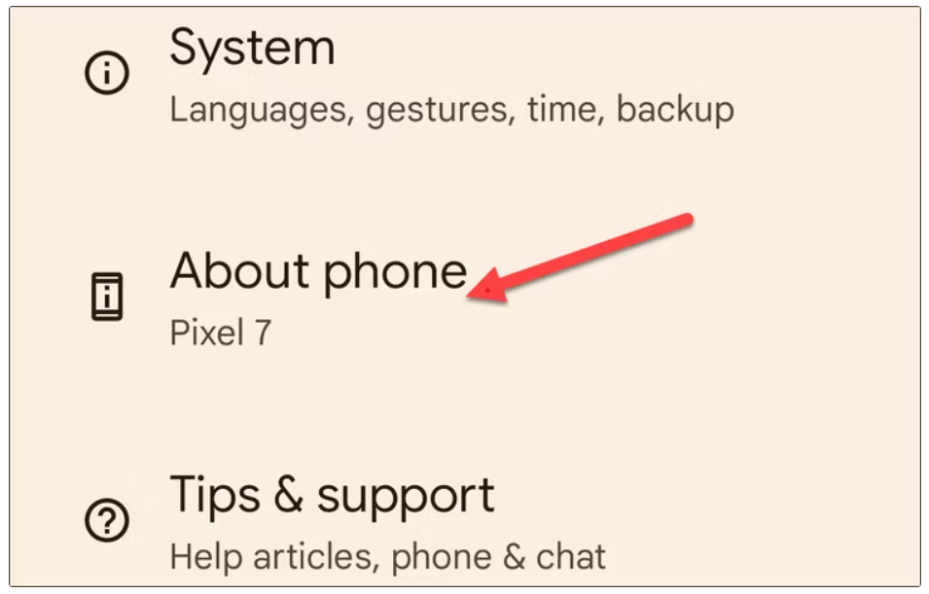
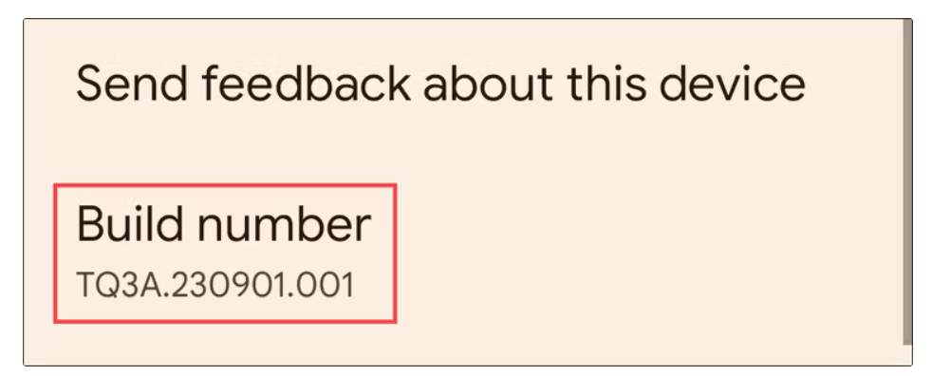
Android Inspect from Windows
Android Phone Setting
Setting -> About Phone -> Build Number 7 times -> open Developer mode

Slide 5
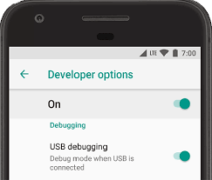
Developer Options
USB debugging ON

Slide 6
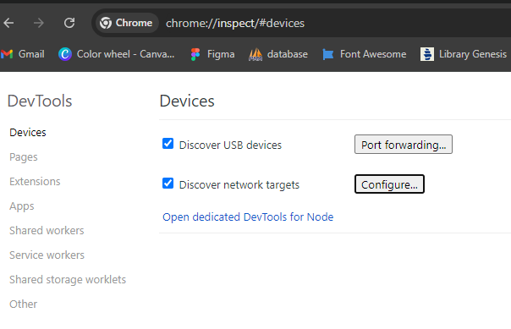
Url -> chrome://inspect/#devices
Click configure

Slide 7
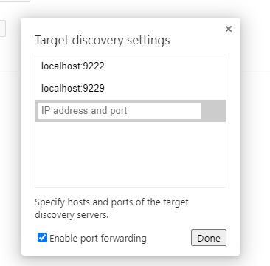
Enable port forwarding ON
On

Slide 8
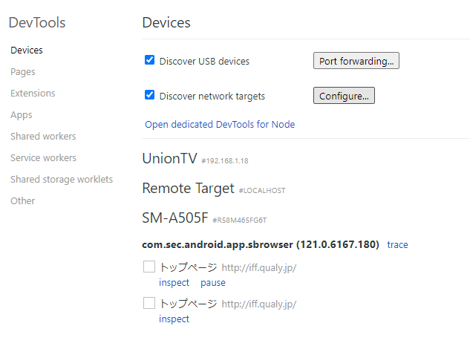
******* Same wifi your phone and laptop

Slide 9
Android Inspect from Windows
- Setting -> About Phone -> Build Number 7 times -> open Developer mode
- Developer Mode -> USB debugging On
- chrome://inspect/#devices <- Url Open in Chrome
- Discover USB devices -> Enable port forwarding ON -> Done
- In Remote Target -> Find your phone

